Slide 1
ELT Kimball Modeling with Visual Metabase
DataCraft :
Dibimbing.id – Final Project Data Engineer Batch 2
Muhammad Muhidin

Slide 2
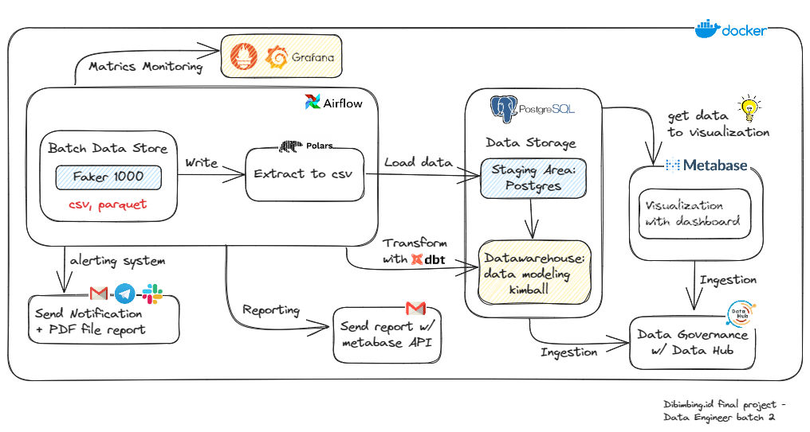
Infrastructure of Pipelines

Slide 3
Data Flow
Extract
Transform
Visualize
Source Data
Staging Area
Warehouse
Metabase
Load
Data
Governance

Slide 4
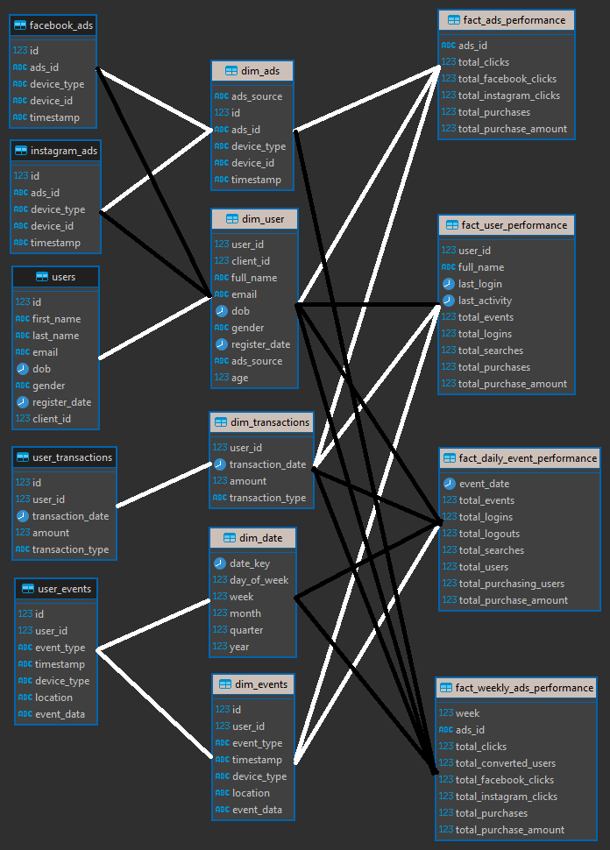
Entity Relationship Diagram (ERD)
relations from dim and fact tables

Slide 5
DBT ( T in Transformation )
dbt_project.yaml and
profiles.yaml
Models
Schema
SQL

Slide 6
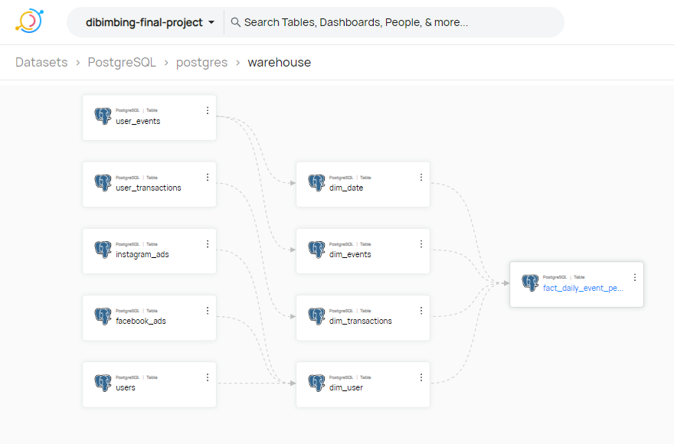
Datahub

Slide 7
Prometheus and Grafana
9125
StatsD
Exporter
9102
9090
3100
Airflow
Prometheus
Grafana
Ingest
Scrape
Source
Dashboard

Slide 8
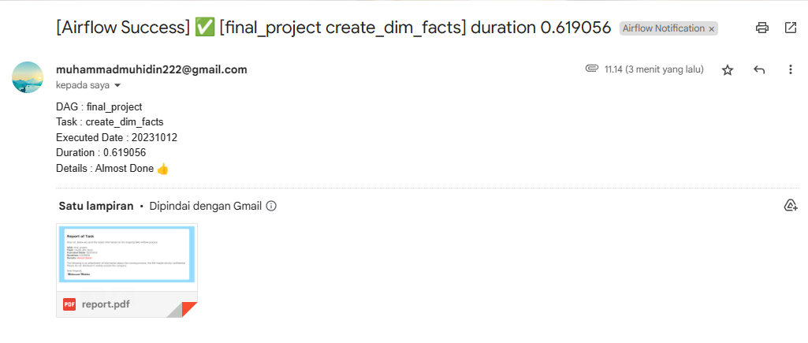
Email Notifications

Slide 9
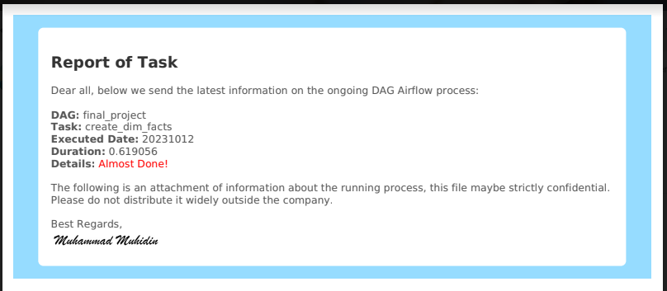
Report Attachment (Email)

Slide 10
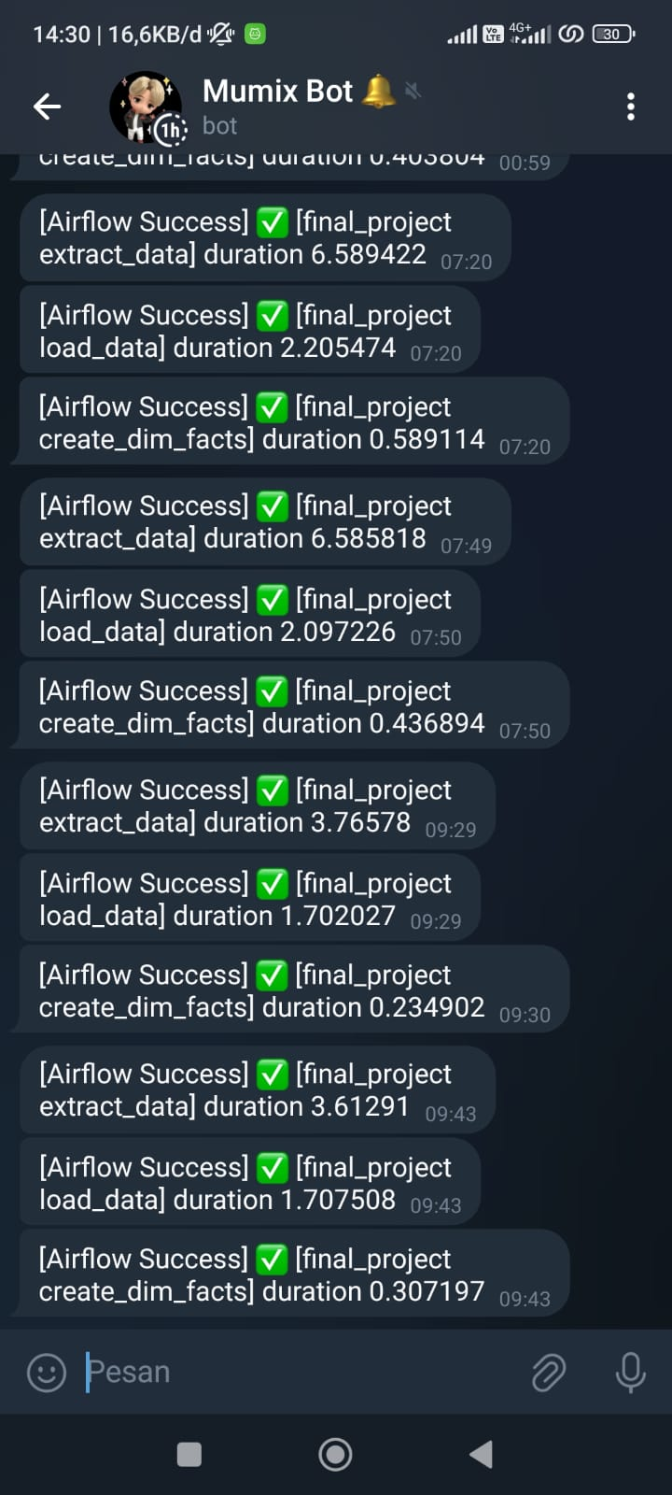
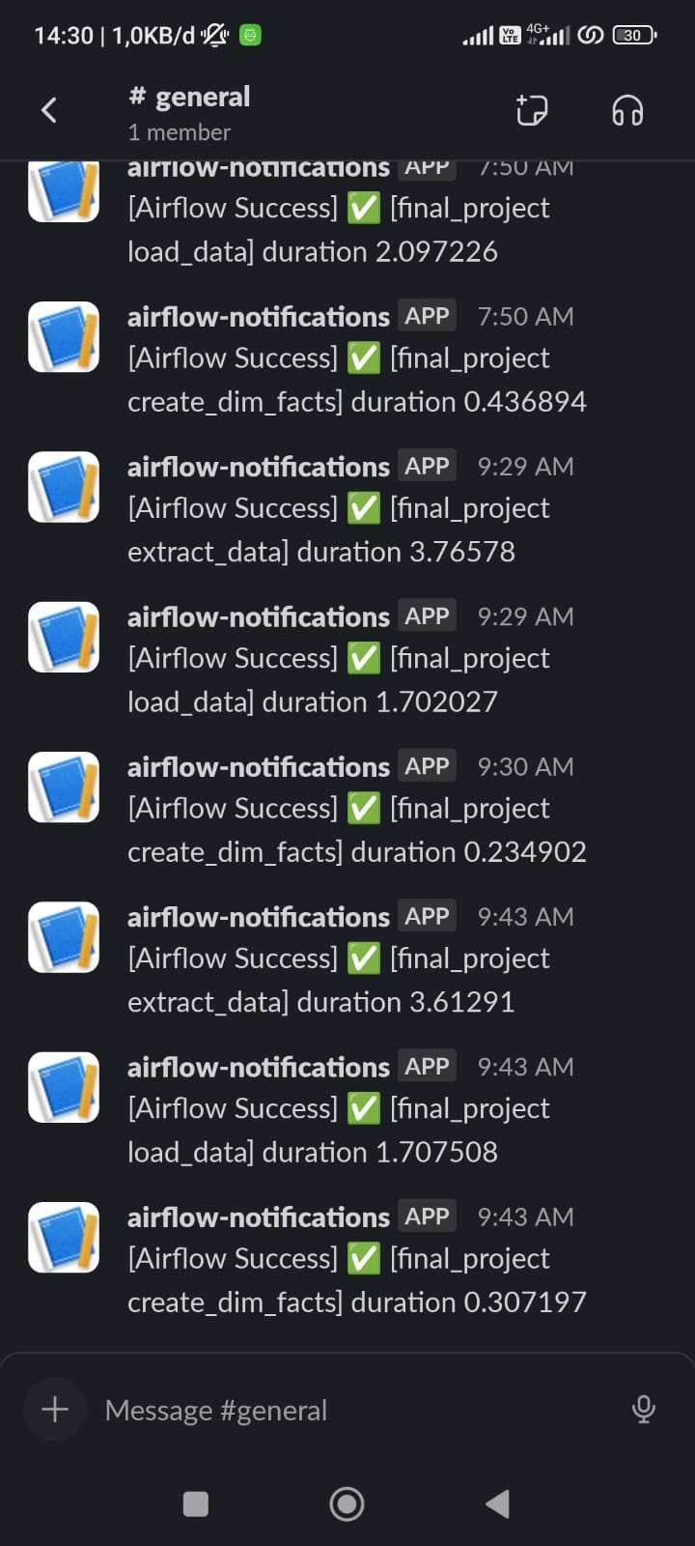
Telegram and Slack Notifications
all statuses on the airflow task instance are success, retry, failure. Also sent to Telegram and Slack.

Slide 11
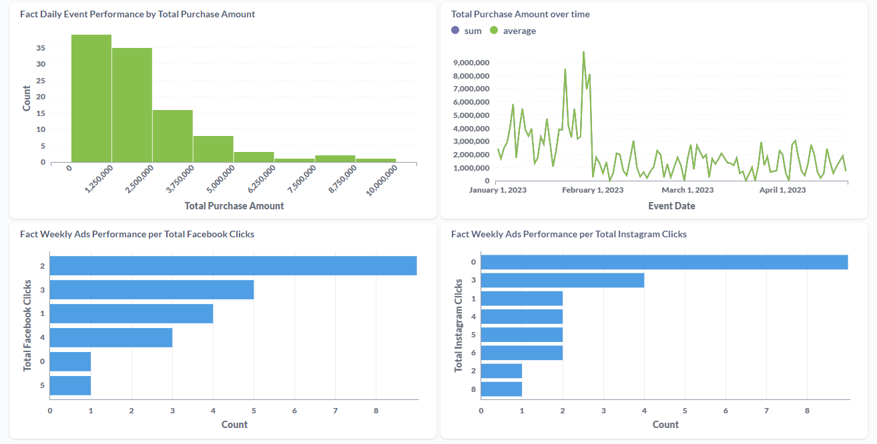
Dashboard of Metabase

